Slide 1

Year 1
RWI workshop
Notes:
Welcome to a brief taster of our whole school synthetic phonics reading programme – Read Write Inc!
Please insert own notes for introduction/welcome.

Slide 2
If English had a simple code, spelling and reading would be so much easier……but it doesn’t!
play mayk (make) trayn (train) playn (plane) bayk (bake)
green dreem (dream) hee (he) happee (happy)
light kight (kite) fligh (fly) Igh (I)
Coat sloaw (slow) hoap (hope) goa (go)
moon froot (fruit) bloo (blue) cyoob (cube)
Notes:
If English had a simple code spelling and reading would be much easier!!
Have a quick read for fun.
But of course, it’s not like this!!

Slide 3
English alphabetic code
44 sounds
Over 150+ graphemes
One of the most complex alphabetic codes in the world.
Notes:
In English we have more than 150 ways to represent 44 sounds, using the 26 letters in the alphabet.
This means we have to group letters together to write some sounds. Show with a grapheme such as ‘igh’.
This makes our language one of the most complex in the world!

Slide 4
Read Write Inc. Phonics
Nursery – Y1 (KS1)
Older children who need to‘catch-up’
Children new to English
What is Read Write Inc. Phonics?
Notes:
Using Read Write Inc. Phonics will ensure all children who come to our school learn to read:
Nursery – Y1
Older pupils who have struggled to learn to read and need to ‘catch up’
EAL pupils
Children with SEN and dyslexia also learn to read using this programme.
Teaching and learning focuses on what children already know and what they need to learn next in order to make best possible progress - by stage not age.

Slide 5

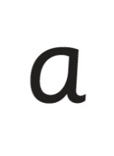

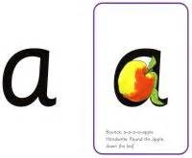
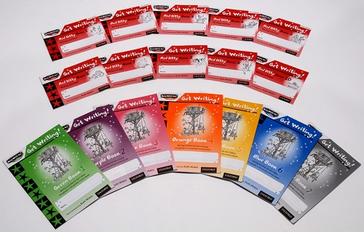




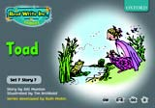
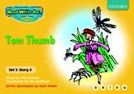

Accuracy Fluency Enjoyment
Reading and Writing
sat
p
mat
d
sad
i
t
n
Notes:
Read Write Inc. Phonics is a programme that uses systematic phonics to teach all children to read.
It lasts two years for most children - if they start to learn to read in the Reception class.
(There are some children with learning difficulties who spend longer on the programme.)
Show cards sets 1 & 2 sounds, green words & red words and books
Click – We teach the sounds first – in a specific order.
Click – We then teach your children to blend those sounds together in order to read words
Click – The children read words in the matched Storybooks. Each Storybook is carefully matched to the sounds they can already read - setting them up for success.
Click – We read to children ‘real’ books’. Once they have learnt to read, they will be able to independently read these books for themselves.

Slide 6
Consonants: stretchy
f | l | m | n | r | s | v | z | sh | th | ng
 |  |  |  |  |  |  |  |  |  | nk
Consonants: bouncy
b | c | d | g | h | j | p | qu | t | w | x | y | ch
 | k
Vowels: bouncy
Vowels: stretchy
a | e | i | o | u | ay | ee | igh | ow
oo | oo | ar | or | air | ir | ou | oy
Set 1 sounds
Set 2 sounds
Notes:
Go through a few sounds quickly with parents using My Turn/Your Turn.
Stress you must not use letter names at this stage – just pure sounds. Stress getting rid of ‘ugh’ to help blending. Parents usually love this bit! Make it fun! Set 1 then long vowels in Set 2.
Explain that when the children are taught the sounds they use the cards and a multi-sensory approach – hold up the cards again.

Slide 7
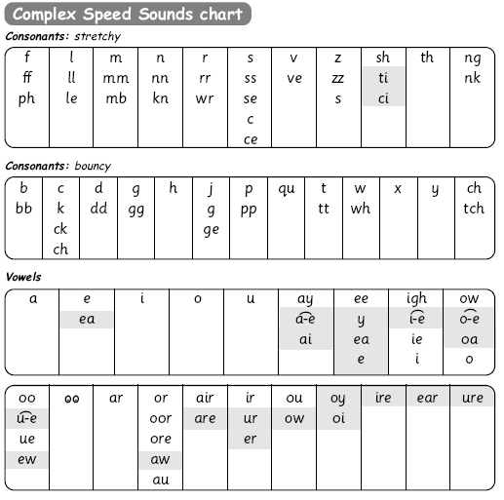
Speed Sounds chart – Set 3
This chart shows the most usual graphemes for the 44 sounds
Notes:
We use this Speed Sounds chart in Phonics lessons.
It shows the most common graphemes for each sound.
Each box is a sound box showing different ways to read and write the sound. Demo the ‘f’ sound box with examples of words ‘fun’, ‘huff’, ‘photo’ and the ‘or’ sound box with examples of words ‘or’, ‘door’, ‘more’, ‘dawn’, ‘author’.

Slide 8
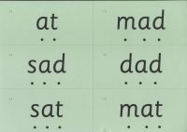
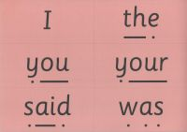
Green and Red words
.
Green words set 1.1
These are the green words from set 1.1. Your child has already learnt these sounds at home. Green words are decidable words, Children know to sound out or ‘Fred Talk’ each sound whilst pointing underneath the letters, then to blend the sounds to make the word. If your child knows them on sight they can read them without sounding out and this is an important progression in their reading. These words can also be found on our school website, just follow the link to Read Write Inc phonics.
As your child progresses to the next level of RWI this card should be returned so it can be replaced with the next group of green words.
Thank you for your support.
at | mat
dad | sad
mad | sat

Slide 9
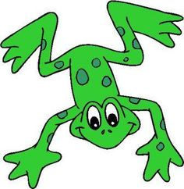
Fred Talk
This is Fred.
He is a frog who can only speak in sounds, and we call this Fred Talk. For example: m-a-t
l-u-n-ch.
He helps children sound out words so they can read and spell.
Notes:
MTYT some examples with the parents. For example ‘m’ ‘a’ ‘t’ mat, ‘s’ ‘a’ ‘t’ sat.

Slide 10
Fred fingers
Fred helps children learn to spell as well!
Children convert words into sounds
They ‘pinch’ the sounds they hear on to their fingers...
We call this Fred Fingers
Spellings
Notes:
Show how to use fingers to spell some of the words you have just blended. Use My Turn Your Turn with the parents – say “show me three fingers – the word is dog.” (or shop or wish or any 3 sound word) “Now put your sounds on your fingers!”
This is the reversibility principle of decoding for reading and encoding for writing.

Slide 11

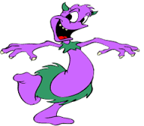
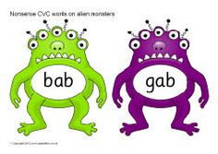
Nonsense words
These words are made up
They ensure that all children understand the sounds and don’t just memorise words
We assess children on real words and nonsense words to ensure that they have a full understanding
What a load of old nonsense!

Slide 12
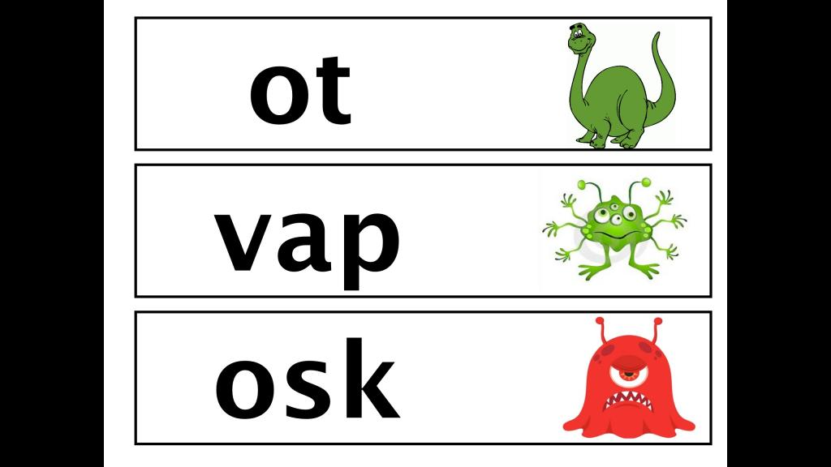
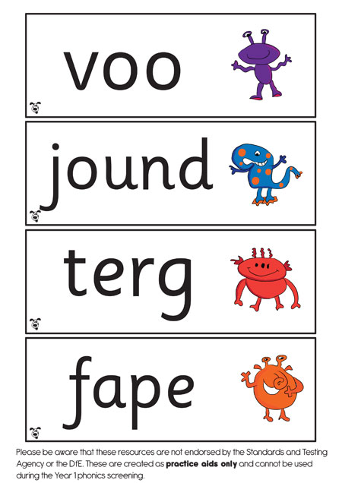
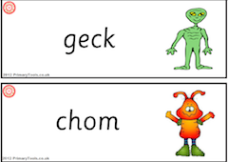

Slide 13
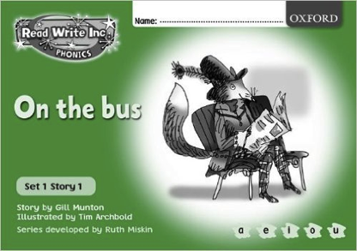
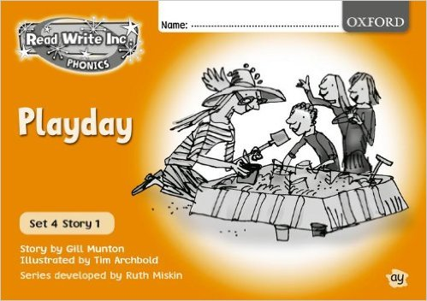
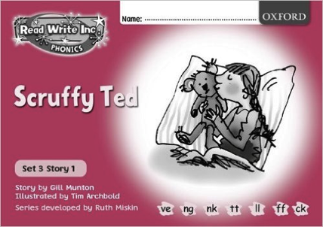
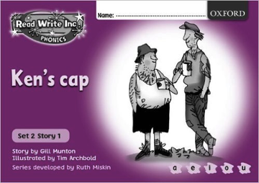

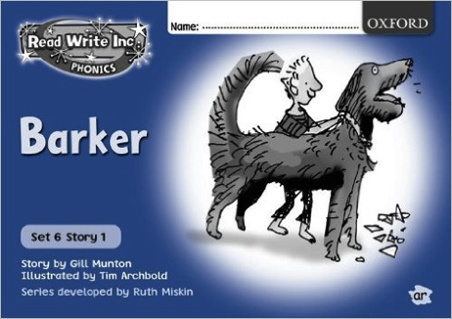
Read Write Inc. Storybooks at home
How can you help?
They must, must, must be brought back please!
Notes:
Storybooks/ black and white paper versions of the Storybooks will be sent home for your children to read.
They will know all of the sounds used in the Storybook as they will bring home the book that they have already read three times in the classroom.
This means they will be able to read the text with fluency and confidence – like a storyteller. They will enjoy reading to you.
This does not mean the text is too easy for them – it means they are reading at the correct level.
We do not send texts home the children cannot read because we always want them to be set up to succeed in their reading.

Slide 14
Assessment
We assess children reading every day informally through hearing them read with their partner
Our RWI Lead Mrs Beveridge will also assess each child twice a term to be able to group them
The children also have a phonics screening check in Year One

Slide 15
Phonics Screening check in Year One
This takes place once a year for Year one children in June.
The children are screened on their set 1, 2 and 3 sounds with real words and nonsense
The threshold has historically been 32 out of 40
If your child scores less than 32 they will re take the check in the June of Year 2 and again in Year 3. This is to ensure no child is left behind.

Slide 16
Teach a child to read
and keep that child reading [and talking]
and we will change everything.
And I mean everything.
Jeanette Winterson

Slide 17
RWI in action!

Slide 18

Any other questions

